Slide 1

FDA Adverse Drug event analysis
December 19, 2022
IST718
Group 1: John Leo Bartlett, Assadour Derderian, Kyle S Walter
Notes:
Assadour?

Slide 2

Project Overview
Healthcare is one of the most noted fields that uses data dictate the actual outcome of an emergency.
One of the major problems involved is the side effect a drug causes when you take another medicine.
This dataset is useful for doctors who seek the best treatment for their patient.
This research project mines the dataset to extract simple, relevant insights for doctors, for patients, and for other interested parties.
Notes:
Assadour?

Slide 3

Filtering and cleanup (SCRUB)
Notes:
Assadour?
data is inteded to be collected through the use of the FDA API, which we need to register for an API key, and create specially crafted URL's that work as API calls.

Slide 4

Data Manipulation
Two way to call the data
Via API that limits to 1000 records and 26 calls per day
File download which was completed through python wget using the API files call
The data set cover 2004-through the most recent quarter of 2021, in effect too large for the computing power to analyze for the project.
Some of fields in the dataset are redundant or not bound for analysis.
Conversion of the data from json to a csv file (more normalized).
Notes:
Assadour?
API limitations, can only grab 1000 records per API call. Can only grab a certain amount of records a day, and certain amount of records per hour. So there are some limitations we had to deal with initially.
Alternatively the .json data is available in a raw file format through the fda's website.
Format is a bit of a pain, there are folders for each year, that contain folders for each quarter, that contain 50+ .json files with un-sorted records. Some of these files are far greater that 1gb+.

Slide 5
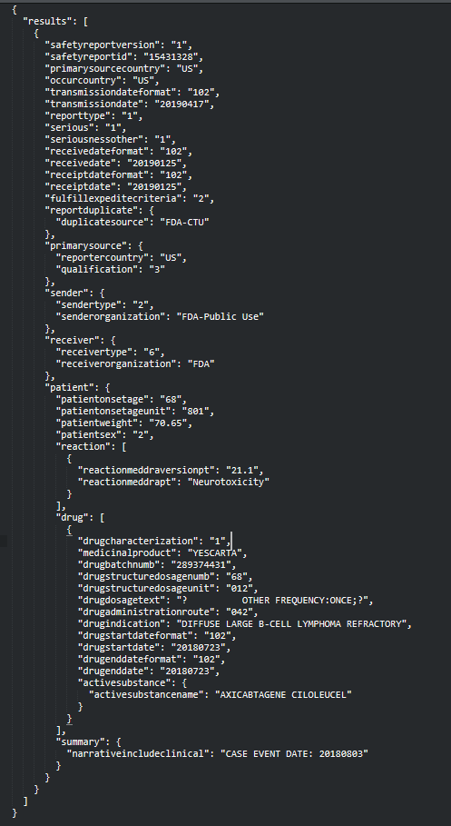
Un-cleaned Json
API results in .json data, the image to the right is an example of one record / adverse event report
Potentially 223 Fields per record. Some fields are nested dictionaries, default normalization doesn't work.
Good cleaning and normalization is a must to get this into a more workable state.
Notes:
Kyle
The structure of the actual json data also adds to the challenge.
Large amount of fields, atypical and messy json data. nested dictionaries and lists. One adverse event record could include 10+ medicinal products.
Cleaning and normalization of this data is a must, and likely key to the success of our future models.

Slide 6


Actions
We narrowed the file by omitting the data that are not provided by medical personnel (i.e., Doctors or pharmacists).
We Cut down the span of data to five years (2016 to 2020)
Converted the dataset from json to csv, which dropped 52 columns.
Further reduced the number of fields from 25 to 16 (the actual and reduced columns of the dataset are listed below).
Notes:
Kyle
Focus on cutting down the size and complexity of our data was our #1 priority.
--JOHN Not sure why these notes are here:
Application Console
- Browser Based access
- Native mobile app
- Easy querying and overview
- Easy to upload data, files (voice, images, etc….)
Cognito – security for the application and the data
ActiveDirectory (AWS Directory Service) – more security allowing integration into enterprise security servers
API Gateway – enabling us to create, maintain and secure API’s
Lambda – AWS Lambda is a serverless compute service that lets you run code without provisioning or managing servers, creating workload-aware cluster scaling logic, maintaining event integrations, or managing runtimes
S3 – storage
EC2 – Virtualized servers for computing, running the app and it’s custom developed services
Glue – a serverless data integration service for performant analytics, analysis and AI/ML
Athena – query the system without having to setup data warehouses…quick access to the data
DynamoDB – a noSQL data storage for flexibility in the datatypes, storing and deploying data in alternative methods for performance and flexibility
CloudWatch – monitoring for DevOpps engineers, developers etc. also enables insight for optimizing for costs and performance
IAM Roles – enables a scalable approach to securely managing access to our services and resources

Slide 7
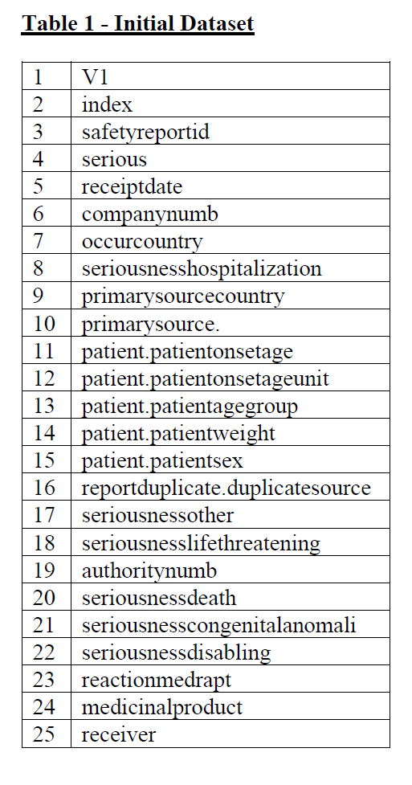
Initial Dataset
Notes:
Kyle
- This is our data after conversion from the collection of loose raw json data, into a ordered csv.
We essentially created a SAVE POINT, for the API data, a shared file, which allows us all to have the same data.

Slide 8
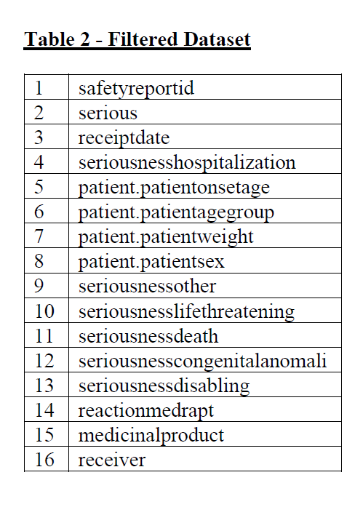
Filtered Dataset
At this stage the csv file had
56 Million Records
209k different medications
18k different reactions reported
Notes:
John
- We then did additional clean up, and dropped more data that we determined to be un-usable.

Slide 9

Observations
Notes:
John?
- data oddities for cleaning
Patient weight 9000 kg?
Patient age 600?
Littered with nan data.
Interestingly some hospitals / treatment centers will report complete false data when these factors are unknow. My friend who is a doctor confirm that in her facility they report age as 200 if they are unable to get the patients age, I.e unconcious.
Also doctors do carry the stereotype of bad handwriting, maybe that plays into bad data input aswell.

Slide 10
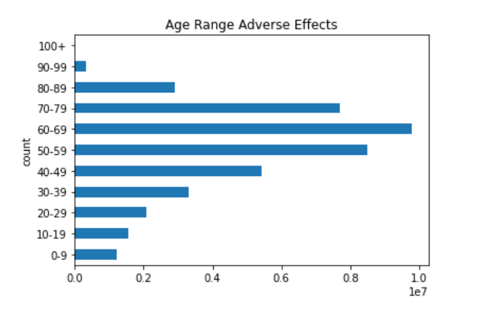
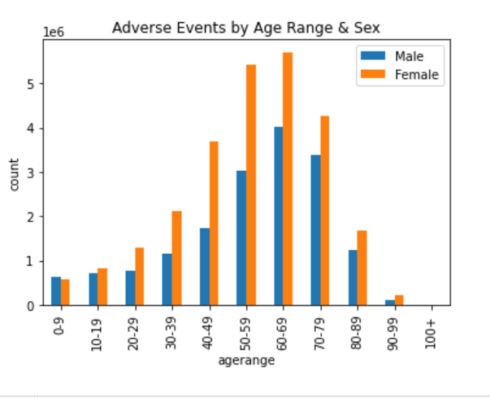
Age Range Adverse Effects
Notes:
John?
Clear indication that adverse effects happen more often to people who are middle aged and older. Aswell as a steep drop off of adverse effects around 70's and 80's.
Our speculation on the cause of this spike is that the older someone gets the more likely they are to develop health problems, this is just a fact of reality. Health problems come with more medication, a unhealthy 70 year old clearly takes much more medication than a relatively healthy 20 year old.
As a result and older person is much more likely to have an adverse reaction to a drug.

Slide 11
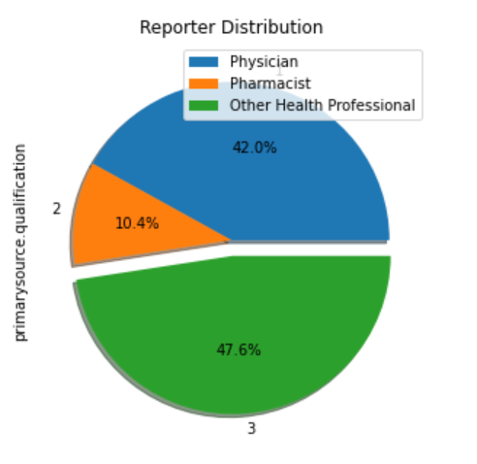
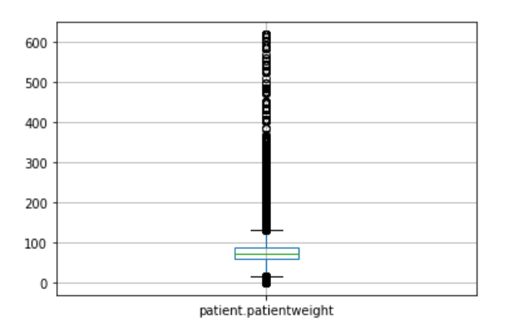
Weight & Reporter Distribution
Patient Weight Box plot
Notes:
John?
Weight distribution is really exactly what you'd expect, falls in line with average population weight. The graph is in kg btw.
Majority of reports in our cleaned dataset are from Physicians and 'Other Health Professionals. Other health professionals, encompass things like specialists, physician assistants, registered nurses etc.

Slide 12
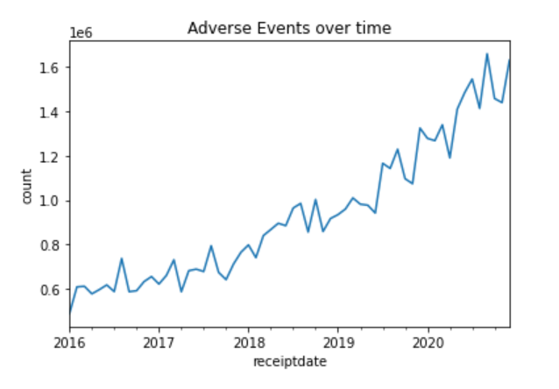
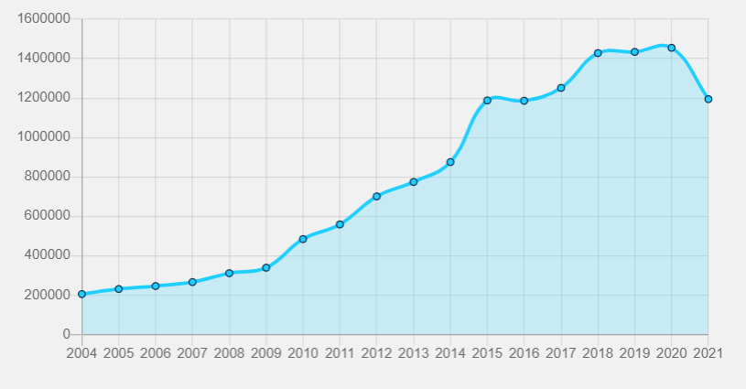
Adverse Events Over Time
Notes:
John?
Reports PER MONTH
Exponential growth of adverse effects. Most likely reflects changes in reporting standards, and a rise of interest in recording these events.
Expanding our data to include the years we cut out from our collection shows a similar pattern. The other visualization is pulled straight from a interactive tool on the FDA API website.

Slide 13
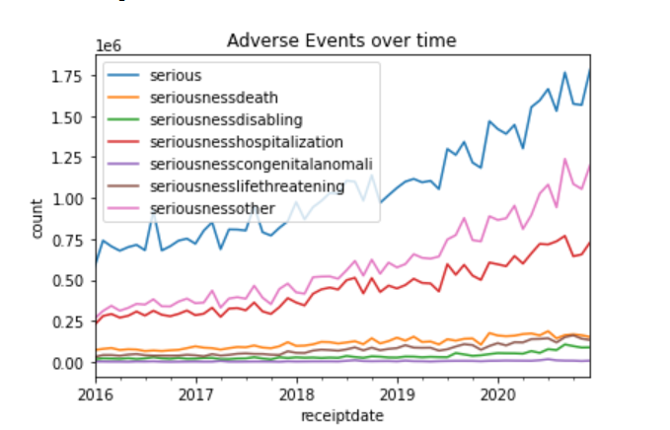
Adverse Events Over Time/Serious Range
Notes:
John?
Breaking down the seriousness data over time, shows the same patterned described in the raw count previously. But also shows some potential correlations between different seriousness categories.
Every record has Boolean value for each of these categories, so often times when an event is labeled, seriousdisabling, it is also labeled serious. This info lead us to think about compiling the various seriousness columns into a single RISK or THREAT, seriousness column.

Slide 14

Modeling
Notes:
Kyle?

Slide 15
Models – Able to predict risk of multiple medications
Dataset transformed to sparse matrix of top 500 reported medications
Retained patient age, sex, and weight for the model as well
Seriousness categories transformed to Risk Measures
High Risk – Death or Disability
Medium High Risk – Hospitalization or Life Threatening
Medium Risk – Congenital Annamolly's
Medium Low Risk – Other Serious
Low Risk – Not serious/No reaction
Train Set ~ 1.2 Million Records
Test Set ~ 0.6 Million Records

Slide 16
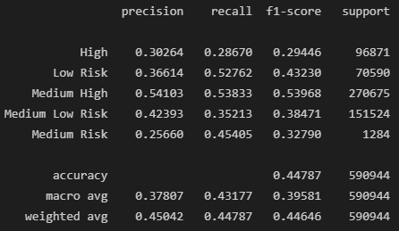
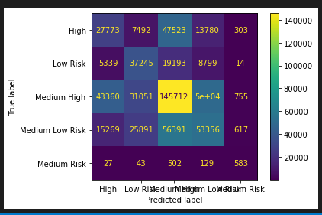
Risk Level Prediction – Multinomial NB
Pros
Model Convergence is Fast ~ 2minutes to converge
Cons
Poor Performance when tested
Notes:
Kyle?

Slide 17
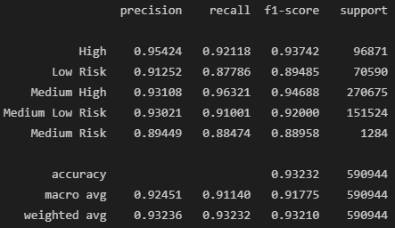
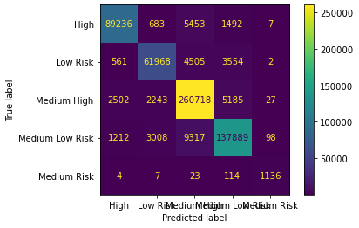
Risk Level Prediction – Random Forest
Pros
High Model Performance, 90% for all labels
Cons
Time to converge ~42 minutes
Notes:
Kyle?

Slide 18
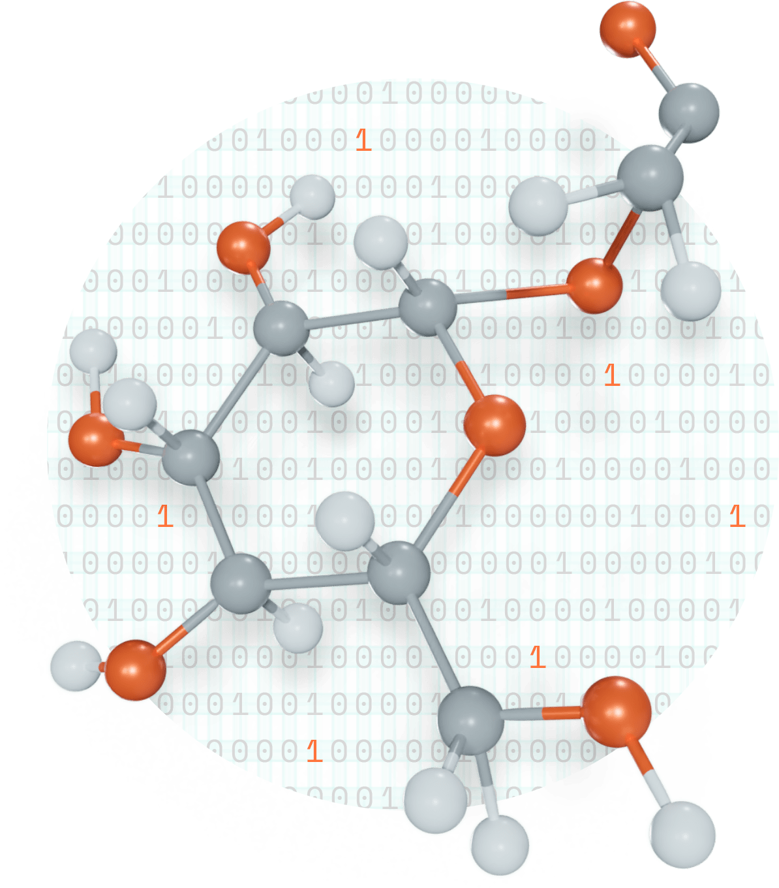
Recommendations
Notes:
Kyle?

Slide 19
Recommendations – Lessons Learned
Recommend the model be built in cloud computing environment that can crunch all medications and required as a step when prescribing medications
Collection of the model's prediction in future report to help narrow in on medical professionals who have an overly large risk appetite.
Json data can be quite messy to work with
More consideration to the amount of data at the start of the project would have helped us narrow scope sooner.
There are other paths that more time could have allowed like looking at ingredients rather than medication name that may have provided for better models

